Slide 1
EEEE2076 – Software Development Project
Project Week1 – Development Tools; Compiling, Linking and Libraries
Paul Evans

Slide 2
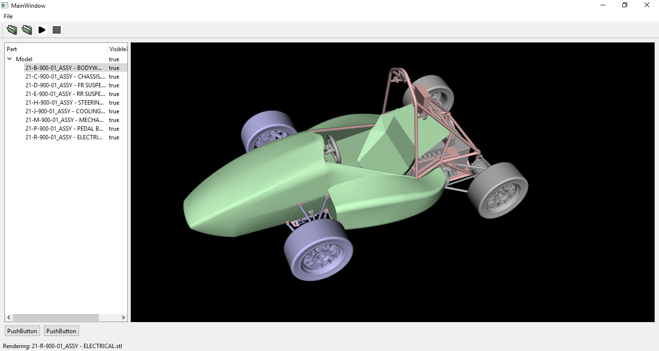
Problems
Complex software
GUI – interaction with operating system at low level
3D View – interaction with graphics hardware at low level
Software development in teams/groups
Interaction, collaboration without conflict

Slide 3




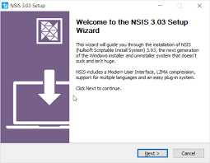

Overview
How are complex programs built?
Implementing advanced features, while minimising effort – libraries.
Software projects using libraries:
Compiling and linking
Use of Visual Studio on Windows
Collaborative software projects
Sharing software projects
Logistics of managing source code
Additional considerations:
Code documentation
Software installers

Slide 4
Git & Github

Slide 5
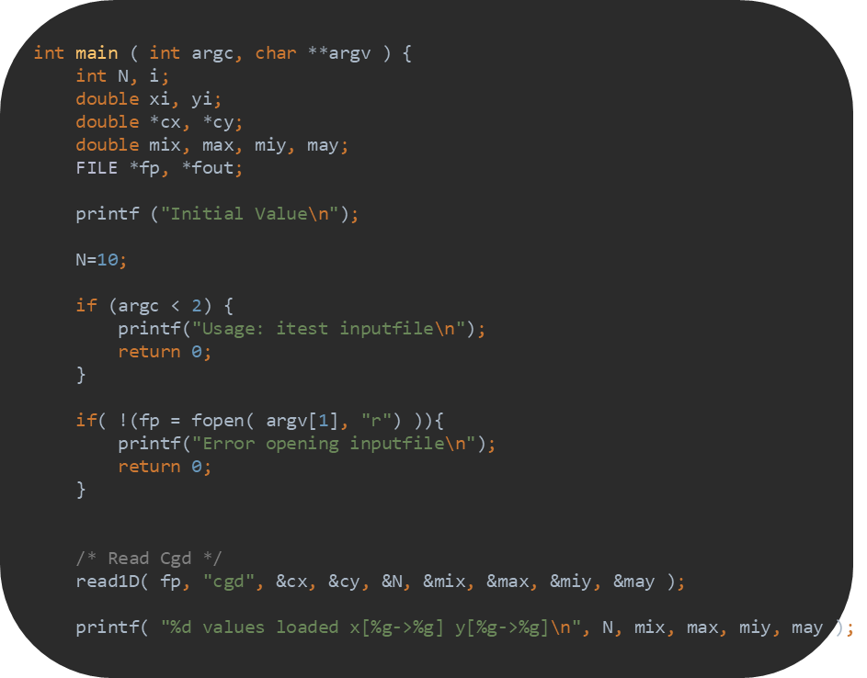
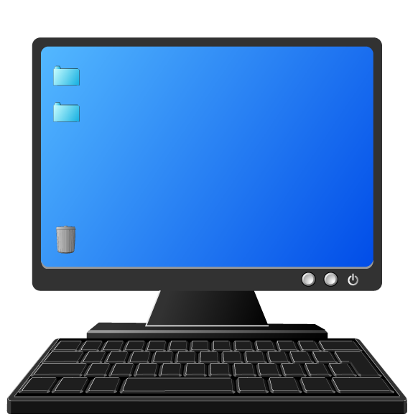




Source Code Management - Problems
Shared source code, multiple users modifying simultaneously
Parallel development branch for testing out bug fixes – main source code remains unaffected until have confidence in fix.
Multiple developers on multiple systems
Version Control
V1.1
V1.1_a
V1.2
V1.1_b
Separate branch for new version, runs in parallel with old version until ready for release
V1.3
V1.4
V2.0
V1.5
V2.1
Need to transfer source code between systems, common repository from which it can be downloaded
Ability for each/any user to modify source code and deal with conflicts. What happens to two people make incompatible changes at same time?
V2.2
Tracking versions – ability to look back at different source code versions – helpful when things accidentally break. Can look back to see what broke it.
V2.3
Once downloaded, source code must be built across multiple systems, each with different IDEs, folder structures, library versions.

Slide 6
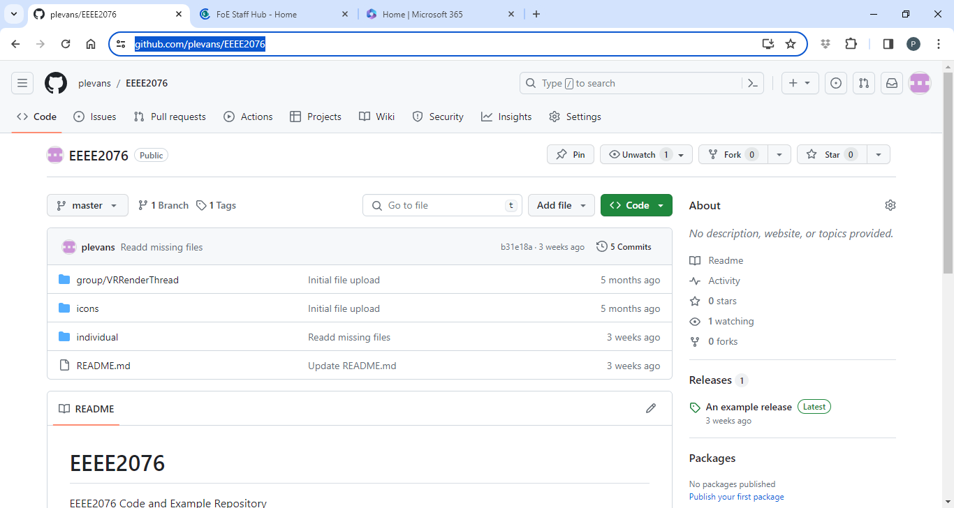
Github – website for sharing code
https://github.com/plevans/EEEE2076

Slide 7
Quick look at Github

Slide 8
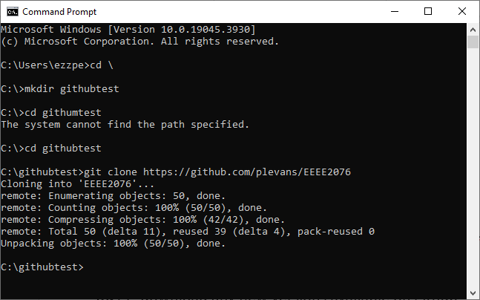

Git and Github
Github – online storage for code
Allows multiple users to add/edit
Git – Tool used by you to interact with Github
Command line interface
clone :create a copy on your PC of something from Github)
add, commit: Add changes to record, create new version
push: upload new version to Github
pull: download any new versions available on github
branch, checkout: manage parallel development paths

Slide 9
Quick look at Git

Slide 10
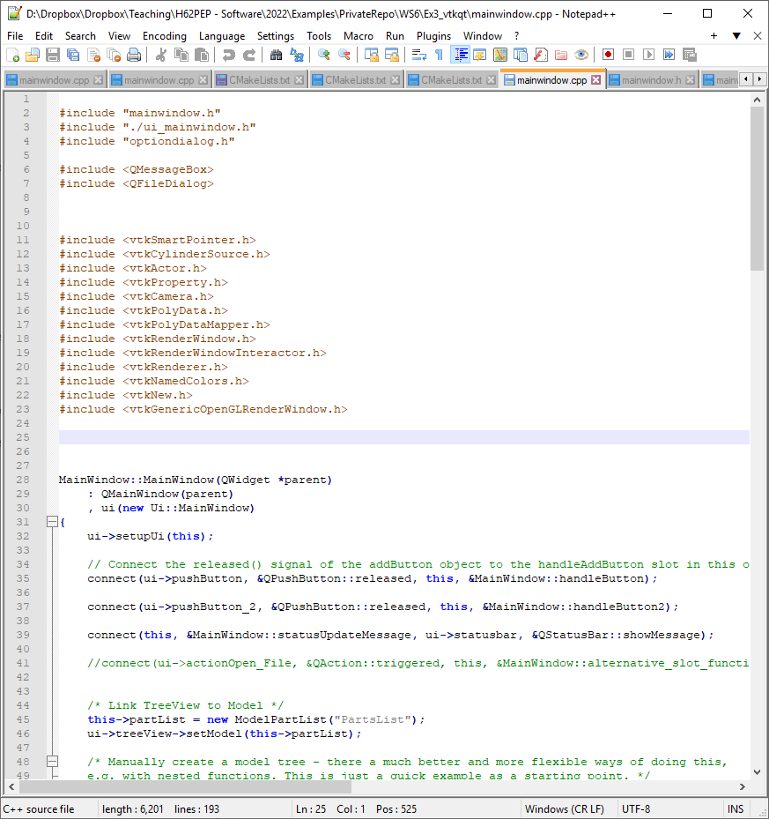
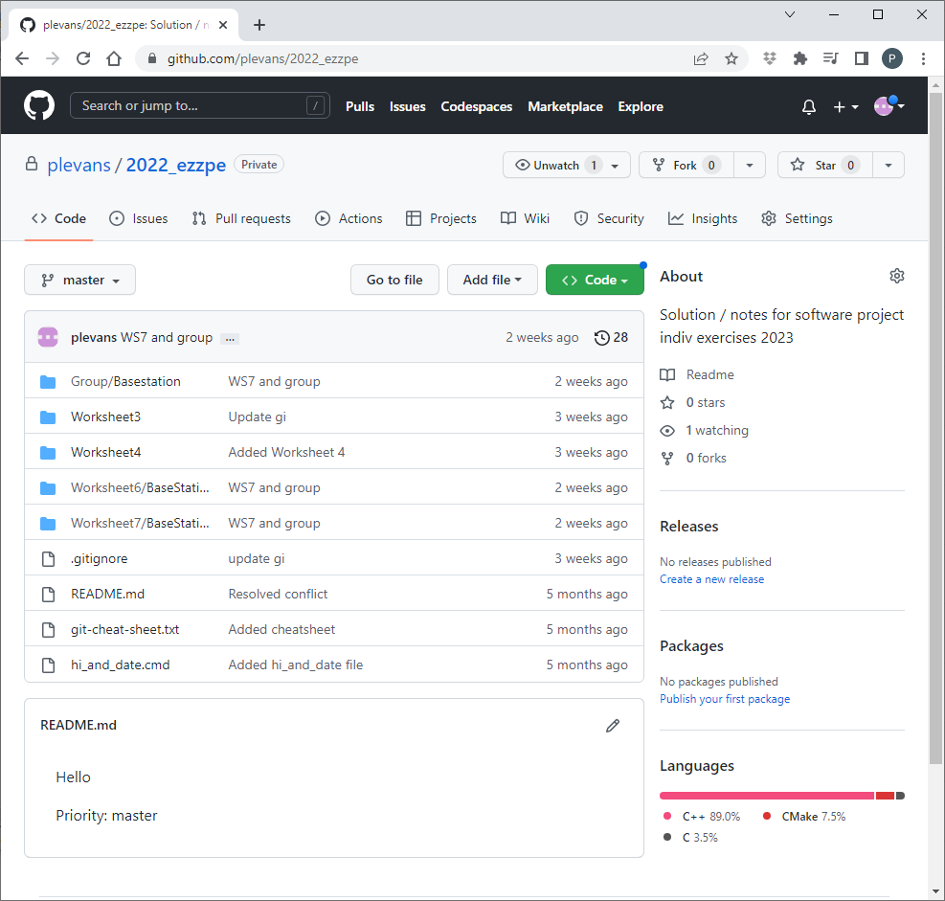
Local Git
Database
Obtaining a copy of an existing github repository
> git clone https://github.com/user_name/repository_name
>
Open a terminal window
Type “git clone https://github.com/user_name/repository_name”
A local git database is created that holds the source code history
A copy of the most recent source code version is also created
Creating a new repository on github website and cloning is easiest way of setting things up
github.com/user_name/repository_name

Slide 11
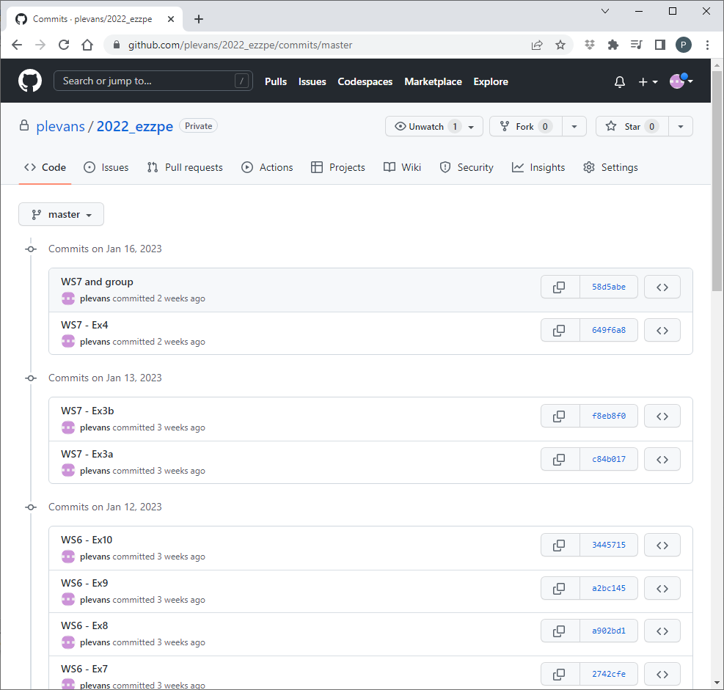
Local Git
Database
Changing source code version
> git checkout 64956a8
>
View different versions (or commits) either on github, or using “git log” command.
Type “git checkout 64956a8” where 64956a8 is the first digits of the git commit to be viewed
Source code is extracted from local database – need to make sure your local database is up-to-date with github
github.com/user_name/repository_name

Slide 12
Local Git
Database
Synchronising local database with github
> git pull
>
Type “git pull”
github.com/user_name/repository_name

Slide 13
Local Git
Database
Recording changes to code
> git add *
> git commit –m “update 1.1”
>
> git push
>
Three stages, 2 local then 1 to update remote
Changes to source code need to be “added” – lets git know they exist
Then “committed” – records changes in local database
Then “pushed” – send changes to the remote (github in our case)
github.com/user_name/repository_name

Slide 14
Local Git
Database
Recording changes to code – if someone else has also made changes
> git pull
> git add *
> git commit –m “update 1.1”
>
> git push
>
You get code from github (git pull), modify, try add/commit/push
If someone gets there first (modifies before you), github will reject your push
You must pull first – git will highlight any conflicts, ask you to change, then you can try again
github.com/user_name/repository_name

Slide 15
1st commit
78ef5
This command, if typed when currently on 3rd commit of master, creates a parallel branch called devel which starts as a copy of 3rd commit
2nd commit
e56f1
> git checkout –b devel
>
3rd commit
564bc
Branches and commits
4th commit
893e1
1st commit
ef5a6
5th commit
5e0e2
2nd commit
903e8
git checkout
Works with specific commits, or branch names (goes straight to latest commit in branch)
6th commit
2375e
3rd commit
a3ed5
7th commit
48791
devel branch
8th commit
4abc5
> git checkout master
> git merge devel
master branch
To merge work from the devel branch into master
git checkout master (checks out the latest commit on master)
git merge devel (merges code from last commit on devel into master)

Slide 16
Compilers, Linkers and Libraries

Slide 17
A typical program
int main ( int argc, char **argv ) { int N, i; double xi, yi; double *cx, *cy; double mix, max, miy, may; FILE *fp, *fout; printf ("Initial Value\n"); N=10; if (argc < 2) { printf("Usage: itest inputfile\n"); return 0; } if( !(fp = fopen( argv[1], "r") )){ printf("Error opening inputfile\n"); return 0; } /* Read Cgd */ read1D( fp, "cgd", &cx, &cy, &N, &mix, &max, &miy, &may ); printf( "%d values loaded x[%g->%g] y[%g->%g]\n", N, mix, max, miy, may );
int read1D( FILE *fp, char *pname, double **x, double **y, int *n, double *mi1,
double *ma1, double *mi2, double *ma2 ) { char startStr[16], endStr[16]; char line[2048]; double temp1, temp2; int i; *n = 0; fseek( fp, 0, SEEK_SET ); …
More of your code: e.g. read.c containing the read1D() function
printf() function: Not your code, but must exist somewhere?
Your code: e.g. main.c containing the main() function
printf is a library function – you don’t write it, it has been written for you to use.

Slide 18


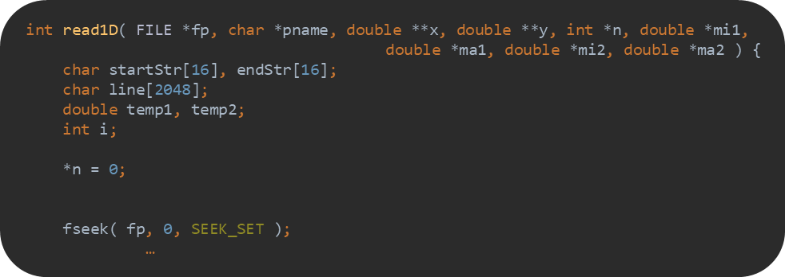
Compilation Process
Compiling – translating human readable source code (words) to code that the processor understands (numbers)
Object files – contain source code for functions, usually one object file doesn’t contain enough information to make complete program
Linker – links together multiple object files to form a complete program.
main.c
main.obj
Compiler
Linker
Program.exe
read.c
read.obj
Source Files
Most programs will have more than one source file
Object Files
Compiled version of source files

Slide 19
Compilation Process
What about printf()?
Contained in a special object file – known as a library.
stdio.h
A library is precompiled code, like an object, but in a format that is easier for multiple programs to reuse
msvcrt.lib
main.c
main.obj
Compiler
Linker
Program.exe
read.c
read.obj
Source Files
Most programs will have more than one source file
Object Files
Compiled version of source files

Slide 20

Libraries
Header file defines library contents – so compiler knows what functions are available
What about printf()?
Contained in a special object file – known as a library.
stdio.h
A library is precompiled code, like an object, but in a format that is easier for multiple programs to reuse
msvcrt.lib
Headers
main.c
main.obj
Import Tables
Compiler
Export Tables
Linker
printf() from msvcrt.lib
read.obj
main.obj
read.c
Executable contains code for all functions, including library, and some header information
Source Files
Most programs will have more than one source file
Object Files
Compiled version of source files
read.obj

Slide 21
Static Linking
This example shows a complete copy of printf() being placed in executable
Would actually be printf() + other functions printf calls
Called static linking
Usually not a good idea!
Every program on computer has a copy of printf
Increased hard drive usage
Every program running is loaded into RAM, each program has a copy of printf()
Increases RAM usage
Printf updated because of bug, every program on computer needs updating
msvcrt.lib
msvcrt.lib
Headers
main.obj
Import Tables
Export Tables
Linker
printf() from msvcrt.lib
read.obj
main.obj
Executable contains code for all functions, including library, and some header information
read.obj

Slide 22

Dynamic Linking
Alternative is dynamic linking
printf is not copied from msvcrt.lib. Instructions for how to find it when the executable runs are included.
The executable’s Import Address Table (Windows) stores this information:
Which functions will need finding/importing
Where they can be found
Idea is that any reusuable function is shared between all programs on a computer.
Dynamic library files are called shared objects (*.so) on Unix derived systems and Dynamic Link Libraries (*.dll) on Windows
Usually quite comprehensive/consistent implementation on Unix derived:
all libraries go into common library folders (/lib, /usr/lib)
Includes libraries you install (/usr/lib)
Windows is a bit more hit and miss:
System libraries, e.g. msvcrt, in \Windows\System32 – equivalent to /lib
User installed libraries – can end up anywhere, can have multiple versions which conflict, may accidentally not be on path and can’t be found, can be a real mess!
msvcrt.dll
msvcrt.lib
Headers
main.obj
Import Tables
Export Tables
Linker
read.obj
main.obj
Executable contains code for all functions, including library, and some header information
read.obj

Slide 23
Dynamic Linking
Headers
Import Tables
DLL is basically an executable that doesn’t have a main() function
It wants to export functions rather than import them
Windows – DLLs can end up installed anywhere, they must be on the path otherwise they won’t be found
Only one copy of DLL needs to exist: both on hard-drive and in RAM
Dynamic linking handled by Windows using Import/Export Address Tables
Export Tables
msvcrt.lib
msvcrt.dll
Headers
main.obj
Import Tables
Export Tables
Linker
read.obj
main.obj
Executable contains code for all functions, including library, and some header information
read.obj

Slide 24
Quick look at libraries on Windows

Slide 25
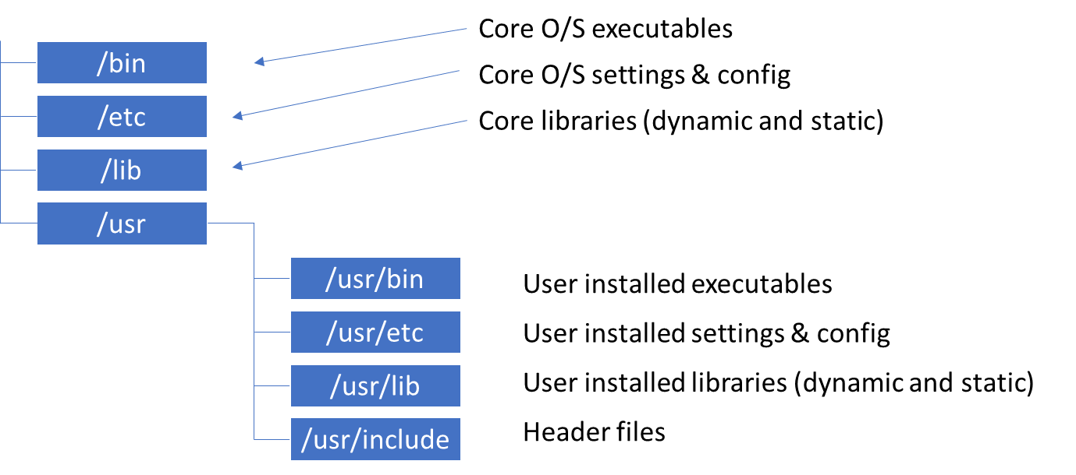
Typical user installed library format (Qt)
In summary: three main components to a library
Linking library (.lib on Windows).
Will exist for both static and dynamic libraries (but smaller for dynamic)
Needed by the linker during build process
Dynamic library (.dll on Windows)
Only for dynamic libraries
Needed by the executable when it runs – must be on path
Header files (.h)
Compiler needs to know what libraries contain when compiling objects
We are dealing with Windows, but Open Source libraries for Windows tend to copy the Unix file system structure

Slide 26


Typical user installed library format (Qt)
Executables and DLLs
C:\Qt\bin
Settings & config
C:\Qt\etc
Static library components (.lib)
C:\Qt\lib
Headers (.h)
C:\Qt\include
Windows
Each program has its own folder (in C:\, C:\program files, etc)
Many libraries copy the Unix file systems structure within this folder – for their components only
Another difference with Windows is that .dlls go in the executable folder (bin)
Unix derived, e.g. Linux
Usually each library / program is installed to common operating system folders

Slide 27
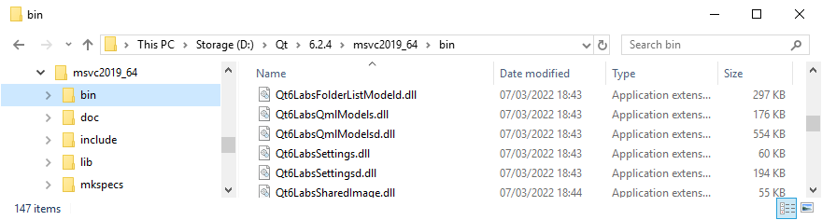
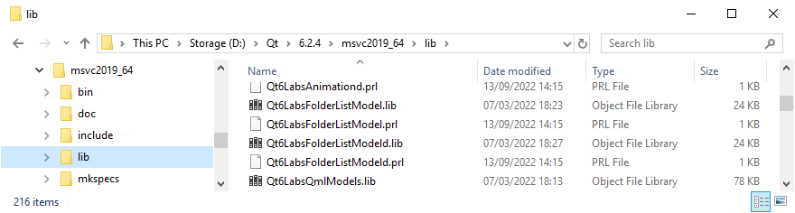
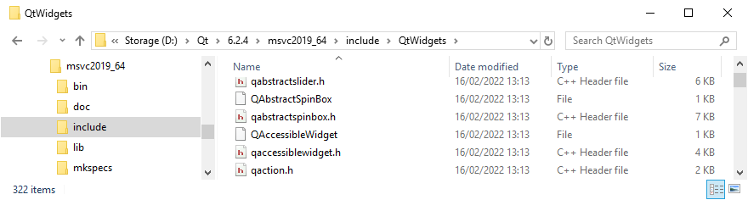
Qt Library Folders
bin sub-directory – binaries, e.g. .dlls
lib sub-directory – libraries, e.g. .libs
include sub-directory – libraries, e.g. .h
Your code needs headers that to tell the compiler which functions are in the library. E.g: stdio.h contains definition of printf()

Slide 28
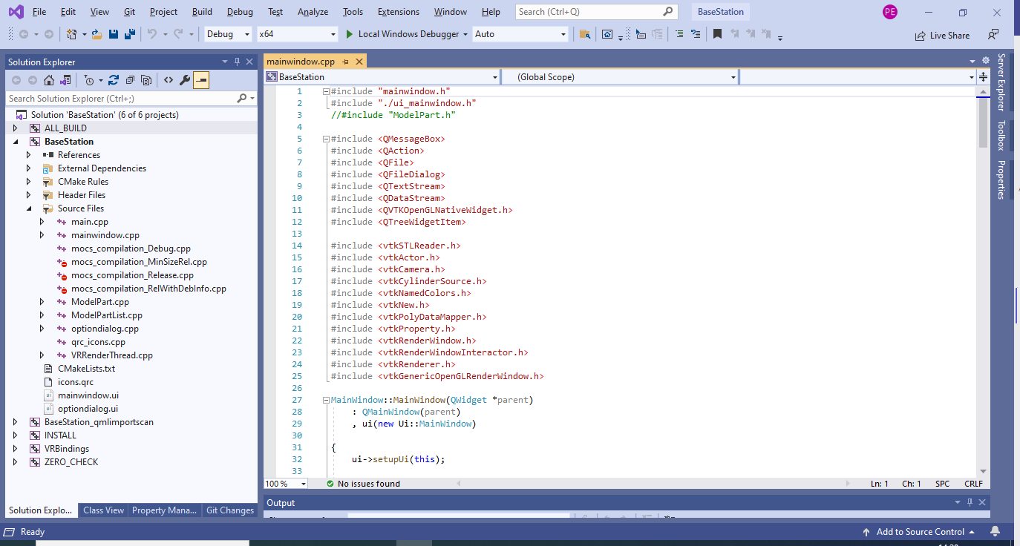
Building with an Integrated Development Environment (IDE)
From library include folder
Header Files
Compile
Object Files
Source Code
Compile
Link
Output
e.g. .exe or .dll
Static Library Files
Link
From library lib folder

Slide 29
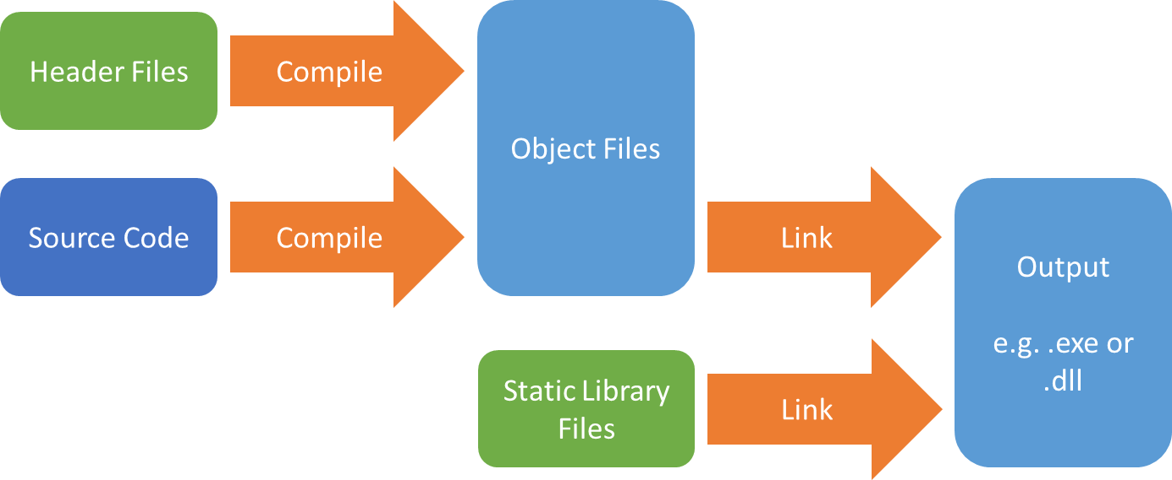
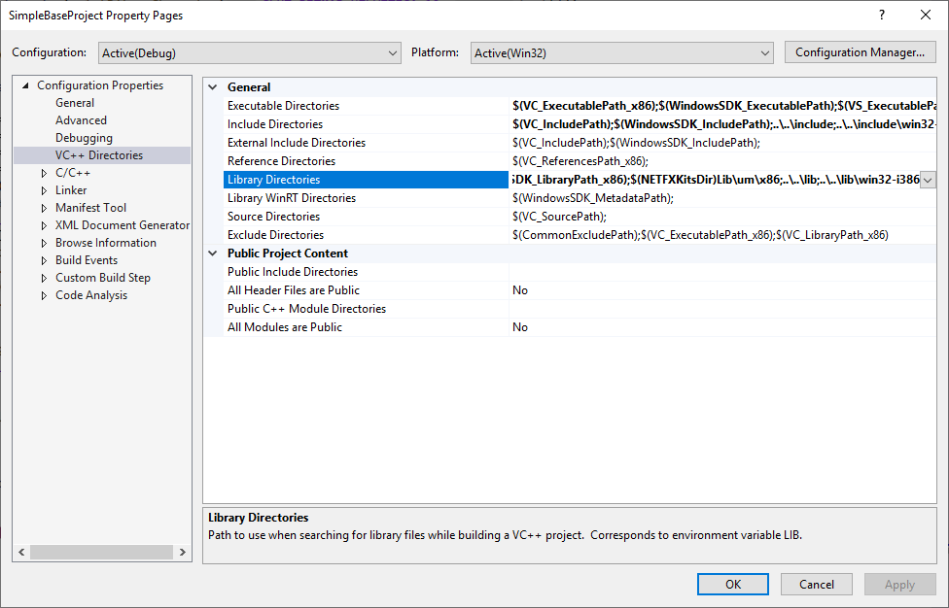
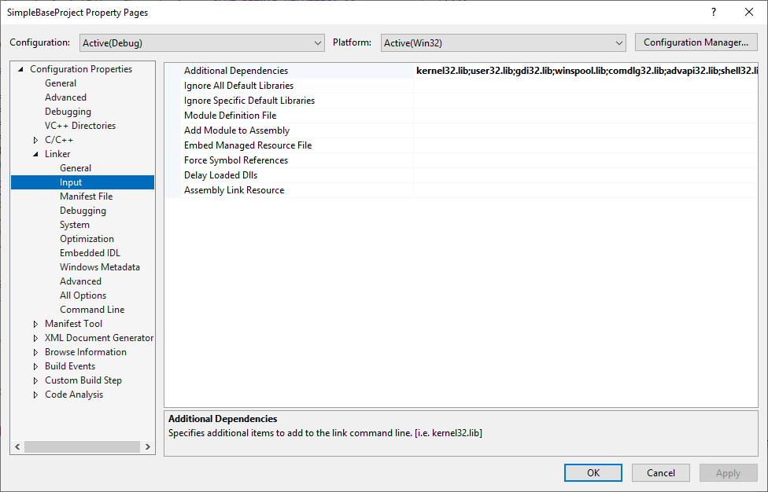
Building with an Integrated Development Environment (IDE)
IDE handles your source code – you add a source file, it knows that means another object that must be linked to the .exe
Generally, you need to tell it:
Where the headers are (list of include directories for your libraries C:\Qt\include )
Where the libraries are (list of lib directories for your libraries C:\Qt\lib)
A list of libraries to link to, e.g. .libs
These lists are not usually the same on any two PCs!
People install things in different places, have different versions of libraries
There can be a very long list of directory paths and libraries that need adding to the project to make it build
You cannot share projects for IDEs like Visual Studio – must create one for each PC that will build the code
Paths in project for one PC won’t work on another
This is very time-consuming for large projects that use many libraries

Slide 30

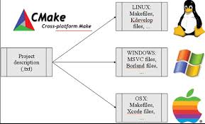
Cross System Build Tools
We will use Microsoft Visual Studio as the development environment (IDE)
Does the same job as Code::Blocks, but better
Problem: If you just create a project in Visual Studio, then add it to Github, it won’t work for other group members
Project contains system specific paths to files needed by compiler
Solution: Use Cross System Build Tool such as CMake
Write a generic “project”
For CMake, this is in a file called CMakeLists.txt
User downloads code including CMakeList.txt
CMake program converts generic project to a specific project for that user
CMake can generate projects for lots of different systems/IDEs
Your own Visual Studio project, and any files generated by Visual Studio when compiling should never be added to Git
Each user generates own specific project

Slide 31
The Build System approach
CMakeLists.txt
Generic project description
Have a project that builds the IDE project
General purpose project – no paths, just describes which libraries are needed
Tool processes general purpose project, searches for libraries, creates specific project for your IDE/PC
Build the specific project to create your executable
Autotools was used for this on Linux/other derived Unix OS:
./configure run configure script to generate
Makefiles
make run make program which controls compileand link
CMake is a more modern version of this, which works on many different OS
CMake configure
CMakeCache
(List of settings for your PC)
CMake generate
Visual Studio Project

Slide 32
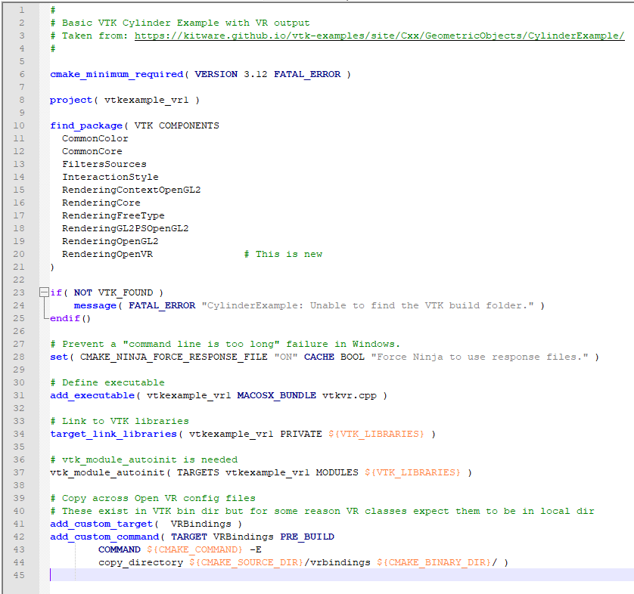
CMake
Path to build folder – where to put project.
Should NOT be same folder as source code
Should NOT be added to Git
Path to project & source code
1
2
3

Slide 33
Example – Using Cmake with Visual Studio

Slide 34
Code Documentation and Installers

Slide 35
Code documentation - Doxygen
Code Documentation
Important for collaborative projects
Explain what functions & classes do
Write documentation with the code
Comments in code explain it
Comments used to generate useful documentation
Use a tool called Doxygen to do this
Github can be configured to generate documentation for you
class ModelPart { public: /** Destructor * Needs to free array of child items */ ~ModelPart(); /** Add a child to this item. * @param item Pointer to child object */ void appendChild(ModelPart* item);

Slide 36

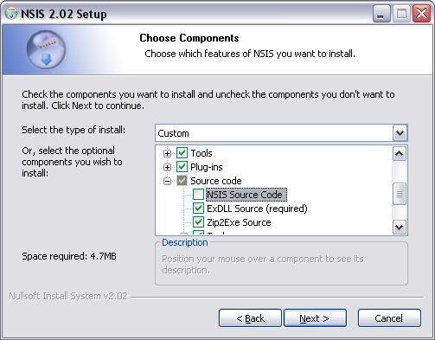
Installers - NSIS
You will need to generate an installer for your software
Use a tool called Nullsoft Scriptable Install System (NSIS)
Can be configured to copy across required runtime libraries (DLLs)
CMake can be configured to automatically generate an installer
You will need to add an installer to Github
This is done using the release feature.
install(TARGETS BaseStation RUNTIME DESTINATION bin/bin LIBRARY DESTINATION lib ARCHIVE DESTINATION lib/static)

Slide 37
Example - Using Documentation and Github - Github releases

Slide 38
Individual Worksheets and Assessment

Slide 39
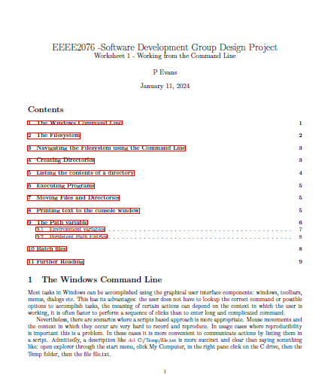
Worksheets – Week 1
You need to understand everything in the previous slides
Worksheets to guide you through this
Using the command line
Git and Github
Visual Studio
CMake
Documentation and Installers
Available on Moodle
Primary focus for the first project week
Code is assessed

Slide 41
Signoff
Signoffs need to happen in lab sessions before 5pm
See David Dewar for signoff
I will deal with technical problems, David sign-offs
Otherwise end up with long wait for technical help
I will help David 4.30 – 5pm on Tuesday/Friday if there are people waiting
5pm is the deadline for signing things off
If you have an ECF approval then we’ll obviously apply the approved, extended deadline

Slide 42
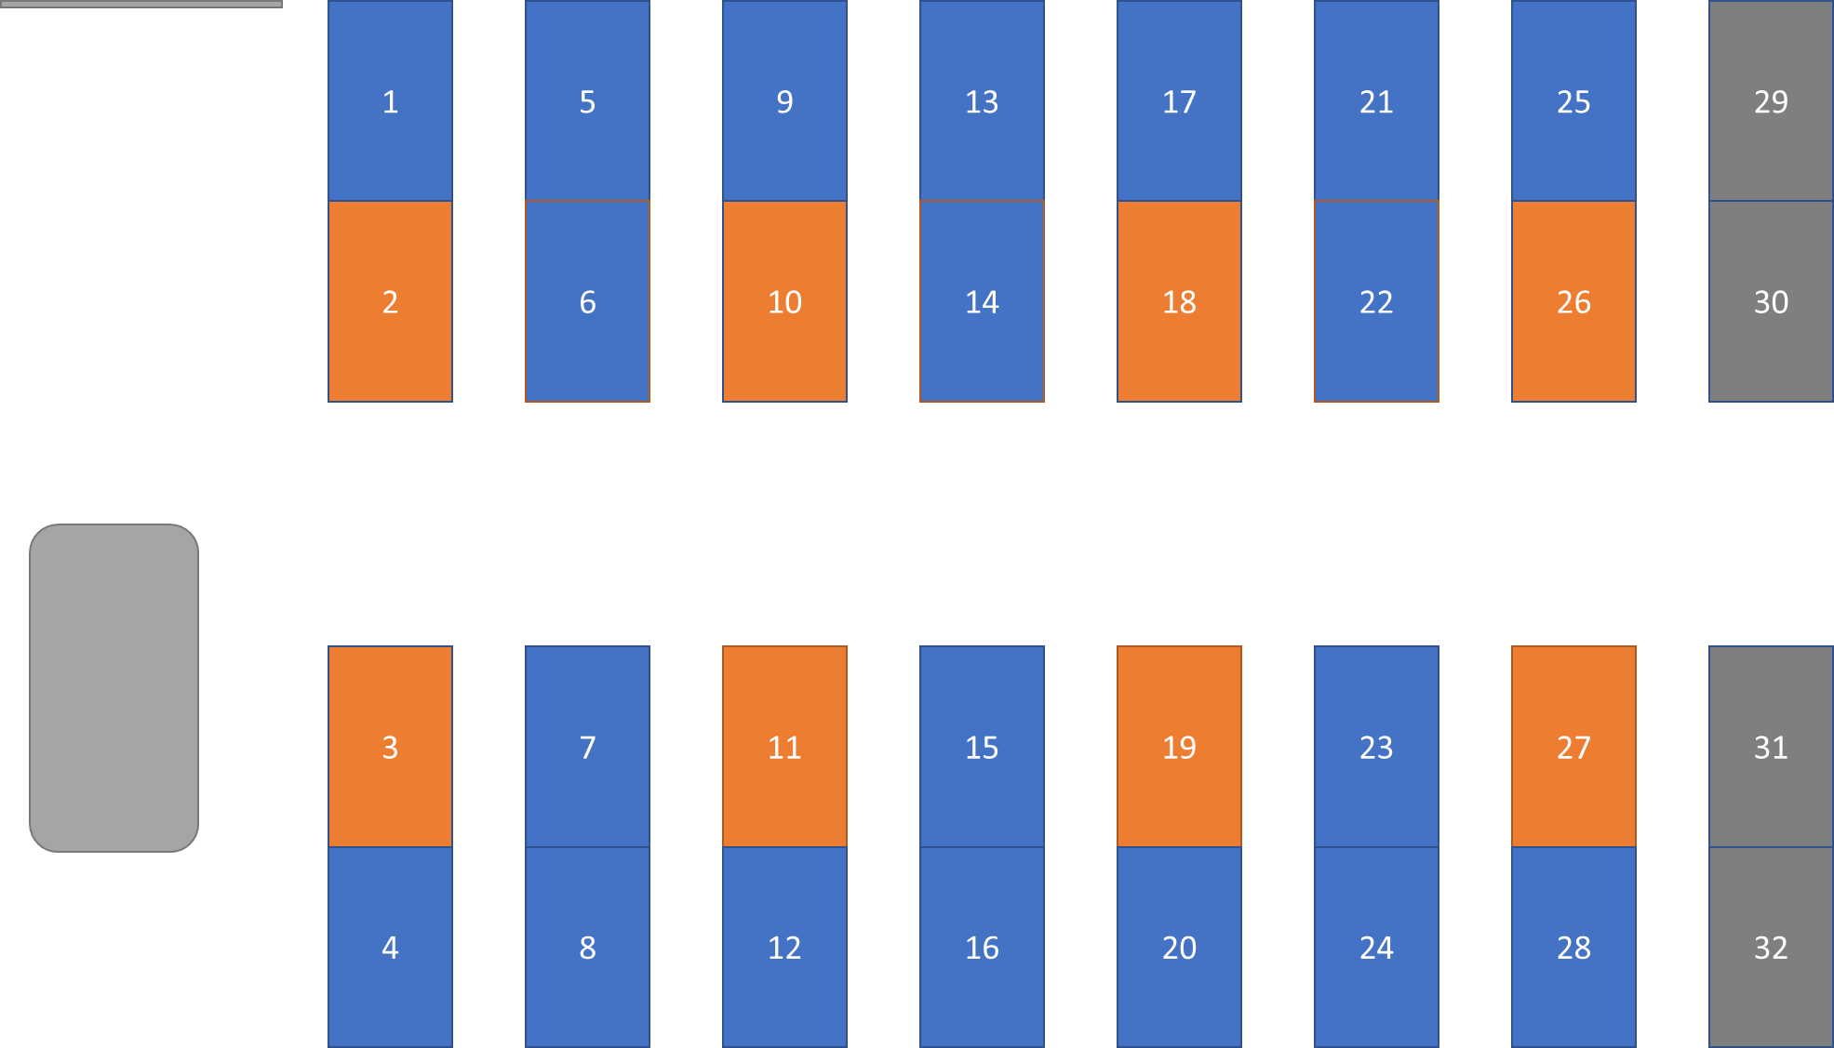
Groups & Lab Computing Facilities
3 people per group, self-selected, system open until Wednesday
Should be 13 or 14 groups
8 Benches reserved for VR systems (<2 groups per VR system)
Use your own laptops, or non-VR PCs in lab for software development, if you want a laptop but don’t have one then university or Mark Birkin can loan you one
Whatever you use should run Windows – technically possible on other operating systems but we cannot offer same level of support.

